Slide 1
UML (Unified Modeling Language)
UML (Unified Modeling Language) is a general-purpose, graphical modeling language in the field of Software Engineering.
UML is used to specify, visualize, construct, and document the artifacts (major elements) of the software system.

Slide 2
UML (Unified Modeling Language)
It was initially developed by Grady Booch, Ivar Jacobson, and James Rumbaugh in 1994-95 at Rational software, and its further development was carried out through 1996.
In 1997, it got adopted as a standard by the Object Management Group.

Slide 3
What is UML
The UML stands for Unified modeling language, is a standardized general-purpose visual modeling language in the field of Software Engineering.
It is used for specifying, visualizing, constructing, and documenting the primary artifacts of the software system.
It helps in designing and characterizing, especially those software systems that incorporate the concept of Object orientation.
It describes the working of both the software and hardware systems.

Slide 4
Conceptual Modeling
A conceptual model is composed of several interrelated concepts. It makes it easy to understand the objects and how they interact with each other.
This is the first step before drawing UML diagrams.

Slide 5
Cont…
Object: An object is a real world entity. There are many objects present within a single system. It is a fundamental building block of UML.
Class: A class is a software blueprint for objects, which means that it defines the variables and methods common to all the objects of a particular type.
Abstraction: Abstraction is the process of portraying the essential characteristics of an object to the users while hiding the irrelevant information. Basically, it is used to envision the functioning of an object.

Slide 6
Cont….
Inheritance: Inheritance is the process of deriving a new class from the existing ones.
Polymorphism: It is a mechanism of representing objects having multiple forms used for different purposes.
Encapsulation: It binds the data and the object together as a single unit, enabling tight coupling between them.
In loose coupling, a method or class is almost independent, and they have less depended on each other.
Tight coupling means classes and objects are dependent on one another.

Slide 7
Cont…
UML diagrams are classified into three categories that are given below:
Structural Diagram
Behavioral Diagram
Interaction Diagram

Slide 8
Structural Diagrams
Structural Diagram: It represents the static view of a system by portraying the structure of a system.
It shows several objects residing in the system. Following are the structural diagrams given below:
Class diagram
Object diagram
Package diagram
Component diagram
Deployment diagram

Slide 9
Behavioral Diagram
Behavioral Diagram: It depicts the behavioral features of a system. It deals with dynamic parts of the system.
It encompasses the following diagrams:
Activity diagram
State machine diagram
Use case diagram

Slide 10
Interaction diagrams
Interaction diagram: It is a subset of behavioral diagrams.
It depicts the interaction between two objects and the data flow between them.
Following are the several interaction diagrams in UML:
Timing diagram
Sequence diagram
Collaboration diagram

Slide 11
UML- Architecture
Software architecture is all about how a software system is built at its highest level.
It is needed to think big from multiple perspectives with quality and design in mind.
The software team is tied to many practical concerns, such as:

Slide 12
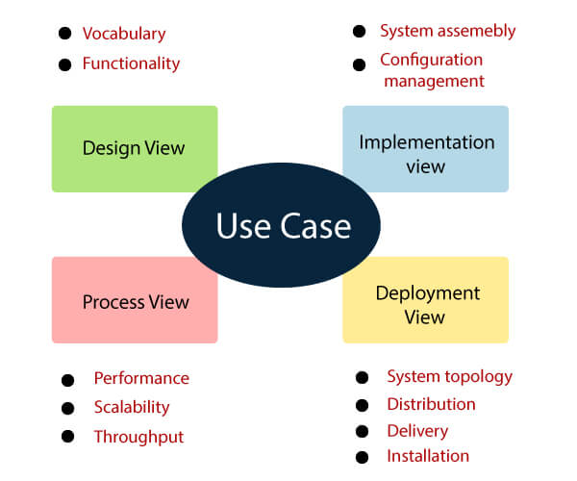

Slide 13

Basic Use Case Diagram Symbols and Notations
System
Draw your system's boundaries using a rectangle that contains use cases.
Place actors outside the system's boundaries.

Slide 14

Cont…..
Use Case
Draw use cases using ovals.
Label the ovals with verbs that represent the system's functions.

Slide 15

Cont…
Actors
Actors are the users of a system.
When one system is the actor of another system, label the actor system with the actor stereotype.

Slide 16

Cont..
Relationships
Illustrate relationships between an actor and a use case with a simple line.
For relationships among use cases, use arrows labeled either "uses" or "extends.
" A "uses" relationship indicates that one use case is needed by another in order to perform a task.
An "extends" relationship indicates alternative options under a certain use case.

Slide 17
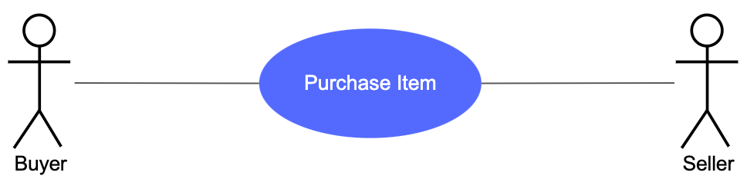

Slide 18
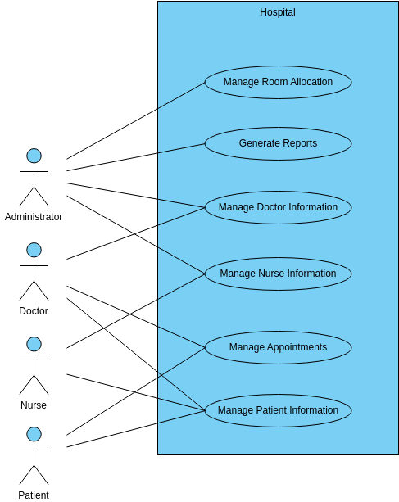
Use Case Diagram for Hospital Management System

